Slide 1

REQUIREMENTS-COLLECTOR ENHANCEMENT:
COMBINING ML AND DL PIPELINES AND EXTENDING THE DATASET
“RUNTIME TERROR” GROUP

Slide 2


PROJECT DESCRIPTION
Speeding up time-to-market of high quality software products
Automatic analysis and classification of requirements specifications and user feedback
Objectives of this study
Extending the Requirements and User Story Dataset
Validate the efficiency and precision of the Requirements-Collector tool
Create a Wrapper Component to combine the ML and DL Pipeline
Research Question
“Does running the ML and DL algorithm using an extended dataset lead to better precision and recall values as compared to the original dataset”

Slide 3

STUDY APPROACH
Creating the Requirements Dataset
Recording a staged requirements elicitation meeting
From audio recording to finished dataset
Complementing the User Story Dataset
Existing dataset
But completely classified as requirements, no NULL values
Combining all datasets to the final Complete Dataset

Slide 4
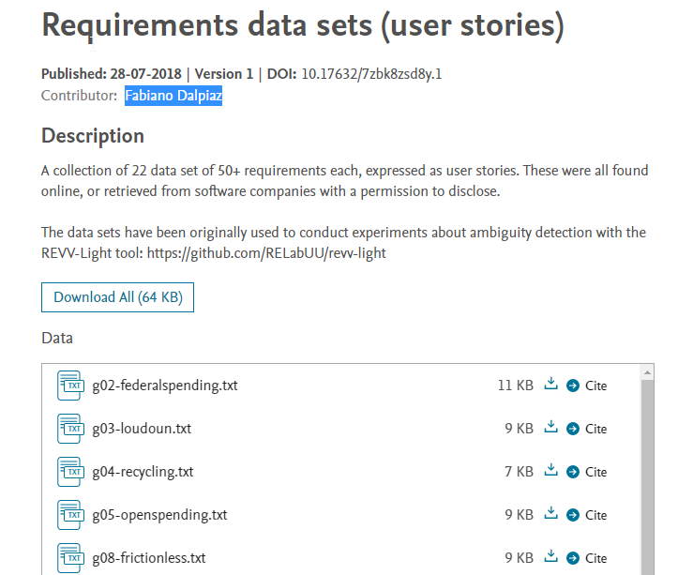
USER STORY DATASET
We collected the user stories from an existing dataset by Fabiano Dalpiaz [1]
Ref [1] https://data.mendeley.com/datasets/7zbk8zsd8y/1
Notes:
The user story dataset was created using a collection of datasets of 50+ requirements each - expressed as user stories - and combining them with randomly selected NULL lines from the existing dataset in the original study.

Slide 5
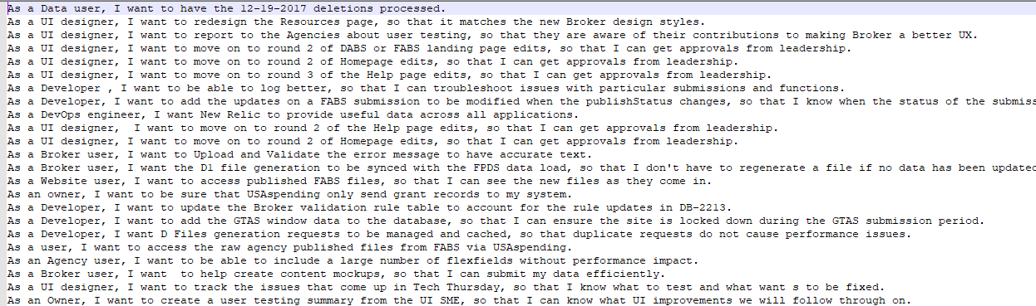
USER STORY DATASET
We collected the user stories from an existing dataset by Fabiano Dalpiaz [1]
Ref [1] https://data.mendeley.com/datasets/7zbk8zsd8y/1
Notes:
We manually labeled the dataset as Functional Requirement (F) or Non-Functional Requirement (A)
The dataset contains 615 lines of labeled lines of tab-separated values, including line number, text content, and classification label

Slide 6
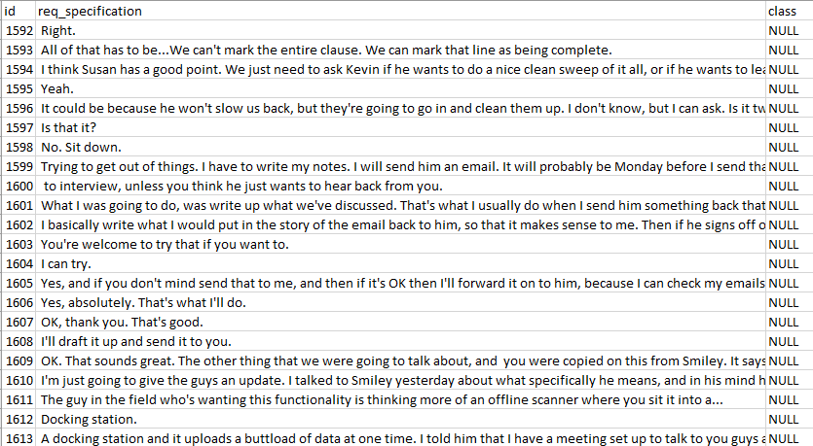
USER STORY DATASET
In order to balance the dataset, we added 600 NULL lines by randomly selecting matching lines from the dataset of the previous work to then receive…
Notes:
We used Microsoft Excel for this by sorting the dataset according to the classifications and shuffling the lines using random sort in Excel. We then combined the findings with our gathered user stories and shuffled the dataset again for its final version

Slide 7
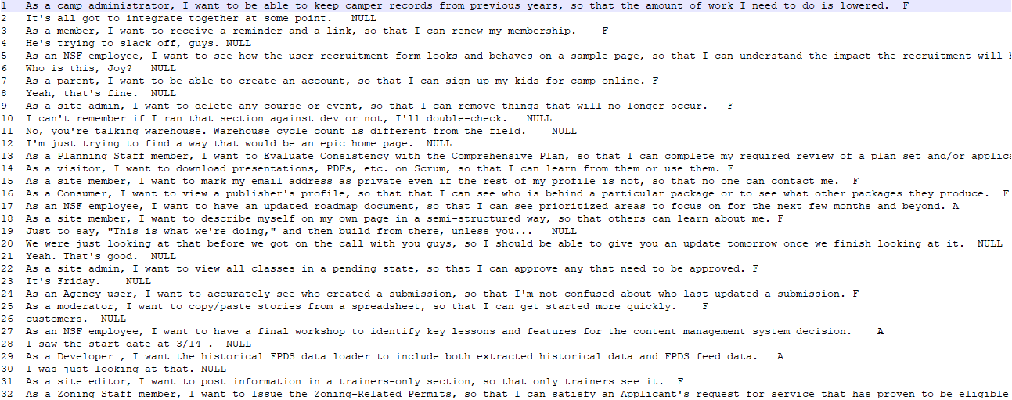
USER STORY DATASET
… the final version of our User Story Dataset (incl. requirements and NULL values)
Notes:
We used Microsoft Excel for this by sorting the dataset according to the classifications and shuffling the lines using random sort in Excel. We then combined the findings with our gathered user stories and shuffled the dataset again for its final version

Slide 8
MERGE OF PIPELINES
Goals
Make execution user friendly
Combine the pipelines into one project
Subgoals
Increase maintainability by refactoring
Make it work on Windows computers

Slide 9
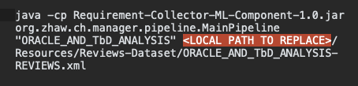
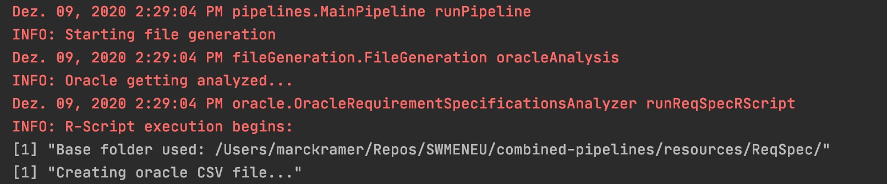
STEP 1: PREPARE ML-PIPELINE
Automatic local path generation
Removed execution by commands
Refactored code
Fixed bug that prevented execution on Windows
Results
Enhanced readability & maintainability
Preparations for next steps
Windows supported

Slide 10
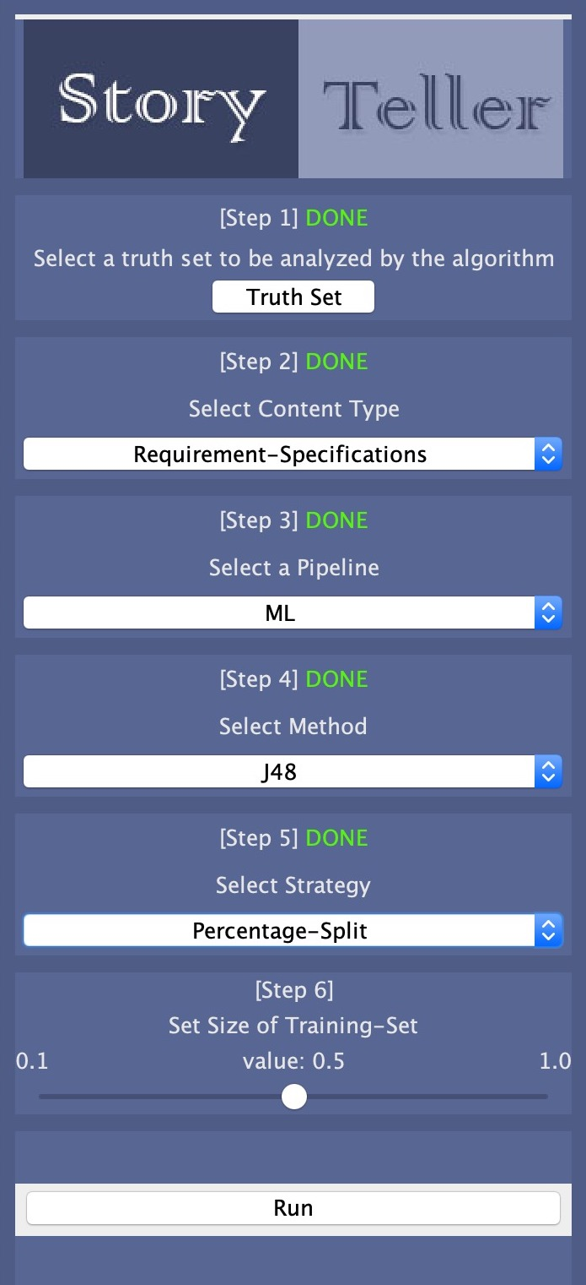
STEP 2: ADD GUI
Allows user to specify
Dataset to be analyzed and its content type
Pipeline
Options for ML Pipeline
Classifier
10-fold
Percentage split for training and test set generation
Results
Made it much simpler to execute Pipelines

Slide 11
STEP 3: INTEGRATE DL-PIPELINE
Integrate DL Pipeline
Refactored code
Use of local paths
Use same generated files as in ML-pipeline
Results are saved to a file
Results
One single codebase
Increased usability

Slide 12
FUTURE IMPROVEMENTS
Add possibility to…
… extend codebase with other algorithms
… run both pipelines in one execution
… run multiple ML-pipelines in one execution
… run one pipeline multiple times and take average of results
… run DL for User Reviews
… change options for DL in GUI

Slide 13
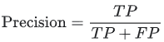
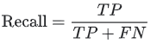

EVALUATION OF ML/DL EFFICIENCY
Precision
“What proportion of positive identifications was actually correct?”
Defined as follows:
Recall
“What proportion of actual positives was identified correctly?”
Defined as follows:
F-measure
The weighted harmonic mean of the precision and recall (test’s accuracy)
Defined as follows:
Ref [2] https://developers.google.com/machine-learning/crash-course/classification/precision-and-recall

Slide 14
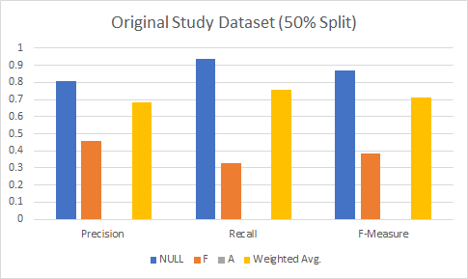
EVALUATION OF ML/DL EFFICIENCY

Slide 15
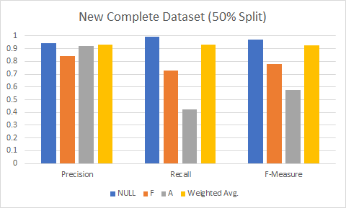
EVALUATION OF ML/DL EFFICIENCY

Slide 16
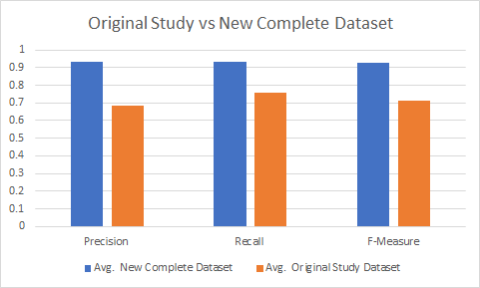
EVALUATION OF ML/DL EFFICIENCY

Slide 17
LIVE DEMO

Slide 18
GITHUB REPOSITORY
Ref [3] https://github.com/Makram95/SWME_G2_HS20

Slide 19

QUESTIONS AND DISCUSSION

Slide 20
REFERENCES
[1] F. Dalpiaz, “Requirements data sets (user stories)”, Mendeley Data, V1, 2018, doi: 10.17632/7zbk8zsd8y.1
[2] https://developers.google.com/machine-learning/crash-course/classification/precision-and-recall
[3] https://github.com/Makram95/SWME_G2_HS20

